Slide 1

Redefining Rural Hospitals
Notes:
We want to see our rural communities not just survive but thrive.

Slide 2
Derek Christensen, Colleen Del Valle, Emily Nelson, Emily Tutt, Tyler Ulmer

Slide 3
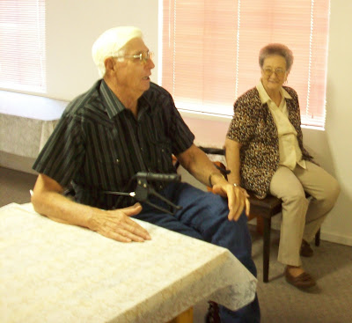
Patient: Mr. Funderburk
Location: Pecos County, TX
Systemic failures in Texas Rural Healthcare lead to the poor quality of life and ultimately the untimely death of our patient.
The healthcare system in Texas failed him
Our solution helps rural communities across Texas deliver healthcare using existing resources
Notes:
-66 yo male who had to serve as primary caretaker for his wife with Alzheimer
-this prevented him from seeking healthcare for his self
-he eventually experienced a fall and in ER evaluation was discovered to have mantle cell lymphoma and suffered multiple complications, arguably preventable, in his post-hospitalization period
-he died 8 month s/p discharge
-the healthcare system in Texas failed him, he did not have access to healthcare in his own community, he did not have access to resources to help support the care of his wife, and we do not want to see other families failed by this scenario
-we believe we have come up with a solution to help rural communities deliver healthcare using resources already existing in their own communities with the addition of some new programs to promote sustainability
-this presentation will use Iraan in Pecos county as a model for our new healthcare delivery system and we believe that this model can be expanded to apply to any group of rural communities across Texas

Slide 4
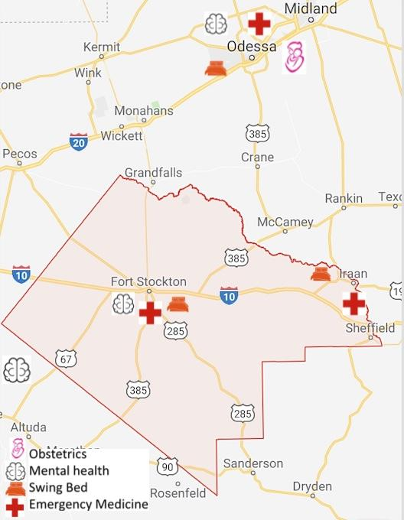
Pecos County, TX
1 hour
1 ½ hours
1 ¾ hours
Iraan
Iraan
Iraan
Fort Stockton
Odessa
San Angelo
Time from East to West: over 2 hours, 132 miles
Total area: 4765 square miles (Delaware 2,489)
Population was 15,507

Slide 5
Counties Across Texas
Counties Explored:
Brooks
Carson
Concho
Dallam
Duval
Garza
Jim Hogg
Kinney
Live Oak
Mills
Rains
Robertson
Common Characteristics of These Counties:
-No OB/GYN
-No General Surgeon
-No Psychiatrist
>20% age 65+ population (except Dallam)
0-1 Hospital available
>15% poverty rate (several >30%)
>25% uninsured rate in population age <65
20-25% Population With No GED/High School Diploma
Pecos
Notes:
The counties listed are those explored prior to this competition. On the right are common characteristics shared by these counties across the board. This shows that these problems are not limited to a single county or a single region of Texas. This is a statewide problem and we are aiming to present a statewide solution.

Slide 6
Challenges Facing Pecos County & Greater Rural Texas
Disparity of healthcare services, quality, and education
Poorly distributed healthcare resources
Underutilized existing community services
Vocational Care, Vocational Service, Vocational Learning
Notes:
A disparity of healthcare services, quality, and education;
Underutilized or overlooked local community resources;
And poorly distributed county healthcare resources.

Slide 7
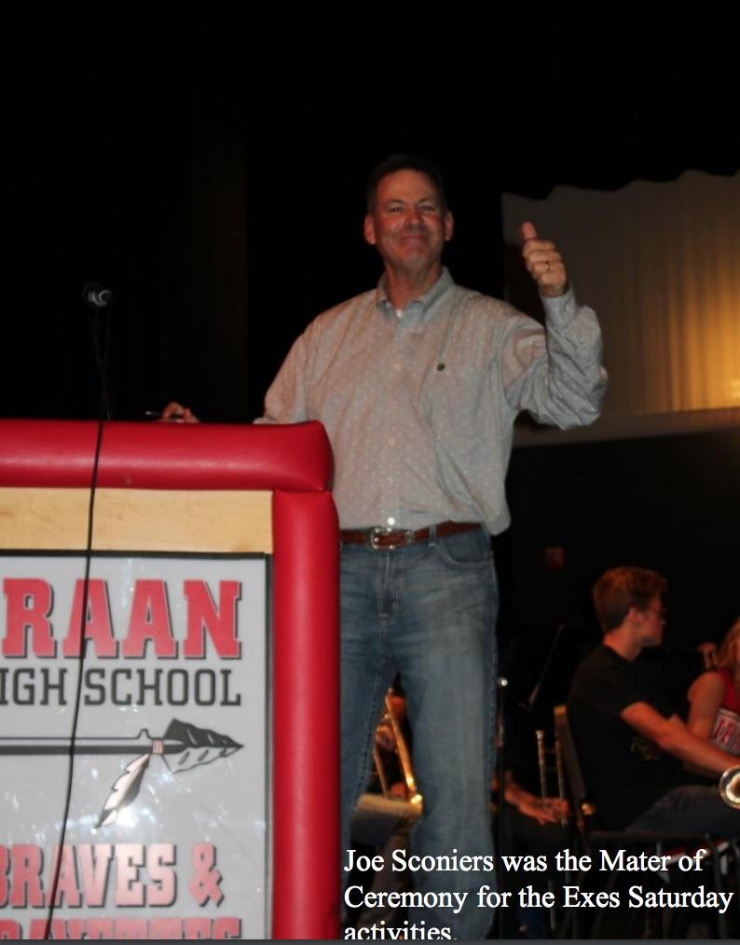
Vocational Care
Health Summit
Assess healthcare resources and their potential redistribution
Repurpose existing infrastructure
  Example: Hospitals transitioned to Freestanding ED’s can repurpose existing structures into community wellness centers or swingbed facilities
Notes:
Encourage a health summit for geographically-linked city or county leaders to evaluate their population’s health strengths and weaknesses. The goal is to coordinate and redistribute healthcare resources throughout the combined populations.
Leaders will be motivated to work with hospitals in their districts to redistribute health services in order to mitigate economic & cultural losses from rural hospital closure documented in literature.
For example, an at-risk hospital could be transitioned to a Rural Freestanding Emergency Department (RFED) reducing redundancy of low-volume, limited-scope hospitals but maintaining emergency service access desired by residents of an area.
The overall goal is to repurpose existing infrastructure to create a collaborative geographical entity with a productive, cost-effective, integrated healthcare network.
We just discussed how a major problem is these counties are failing counties when working indivicially. We need to combine to survive. We propose the creation of a health summit to inform neighboring towns and counties of their existing infrastructure and how to best allocate these resources amongst regional communities. This collaboration will allow greater access to resources and still meet a region’s needs.
We do not want to close existing hospital, but rather redefine what we consider a hospital. Many community members want to retain their hospital facilities out of necessity of emergency care, but how we can use the rest of the hospital structure to continue to benefit one’s community...i.e. Maintain as many non-acute services as possible (specialty clinics, diagnostic services, rehab services)

Slide 8

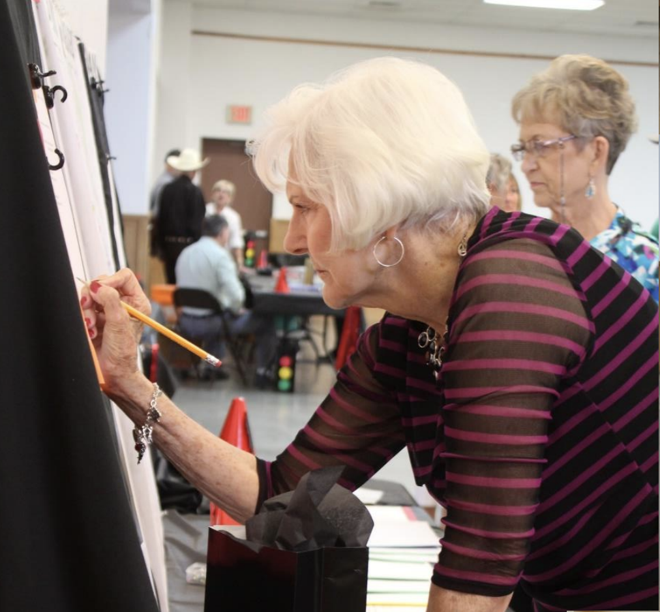
Vocational Service
Community Health Ambassadors
Rural Roads Voucher Program
  Improve patient transportation and quality of life services
  Modeled after Ohio Program “Hospital2Home”
  Healthcare provider will assess patient’s necessary services
  Funded by existing federal and state grants
  Promote volunteerism to mitigate costs
  Program will aim to reduce hospital readmissions and improve overall healthcare outcomes
“Serve our neighbors because we know our neighbors” = Community pride/grass-roots model
Notes:
We feel like the biggest aspect of rural areas is their sense of community and sense of commitment to service--serving others before oneself. The creation of community health ambassadors are an extension of the health summit intended to carry out the plans to meet the needs of the community. These are volunteers who are church leads, school administration, city officials who are well connected among another to help solve problems as they arise. One
Vocational Service
“Serve our neighbors because we know our neighbors”: Utilize the strong sense of community often found in rural settings to power a grass-roots healthcare improvement model.
County officials should identify Community Health Ambassadors who are pillars of the community/members of civic organizations (i.e. church leaders, school administration, city officials, etc) and will be the driving force for recruiting and incorporating members of the community to meet the volunteer needs of the area.
Health Ambassadors will also help promote a Rural Roads Voucher Program:
Modified from a successful model for improving patient transportation and quality of life
Will allow patient access to services deemed necessary by their healthcare provider
Funded by a combination of existing federal and state grants
The goal is to create a network of active community members who work to build up their community’s health system through sustainable volunteer-based programs.

Slide 9

Vocational Learning
Address educational and employment disparities
  Build on existing school district programs such as technical training certificates
Federal & State funding available for training high school students
  Once established, students will help sustain Rural Roads Voucher Program by mitigating some of the costs
Notes:
Address educational and employment disparities in rural Texas by starting with the youth.
High school-centered community care vocation programs build on an already established growing CTE presence in local school districts. Available certificate program options include CNA, Culinary, and Economics/Finance. Federal & State grants and scholarships are already available to fund students who enroll in these programs.
Showcase of these programs will occur at Biannual Health Education & Screening (Iraan Health Fair Partnership). Services provided include immunizations, annual basic lab work, and chronic health screenings. Expertise will be offered to community members by volunteer physicians, Telemed specialists, social workers, and CNA students.
The goal is to provide opportunities to youth that allow them to train in marketable career skills and incentivize them to stay and serve their community for years to come.
Showcase of these programs will occur at Biannual Health Education & Screening (Iraan Health Fair Partnership). Services provided include immunizations, annual basic lab work, and chronic health screenings. Expertise will be offered to community members by volunteer physicians, Telemed specialists, social workers, and CNA students.

Slide 10

Graduate With Trade Certification
Current Certifications at Iraan High :
Commercial Truck driving
Economics/Finance
Industrial
Veterinary Technician
Why not?
Certified Nursing Assistant
Notes:
Example: Use of CNA students to act as the personal health aide 1 day/week
Biannual Health Education & Screening (Iraan Health Fair Partnership):
Opportunity for chronic health screening
Way to involve medical providers/students/specialists either in person or via Telemed

Slide 11
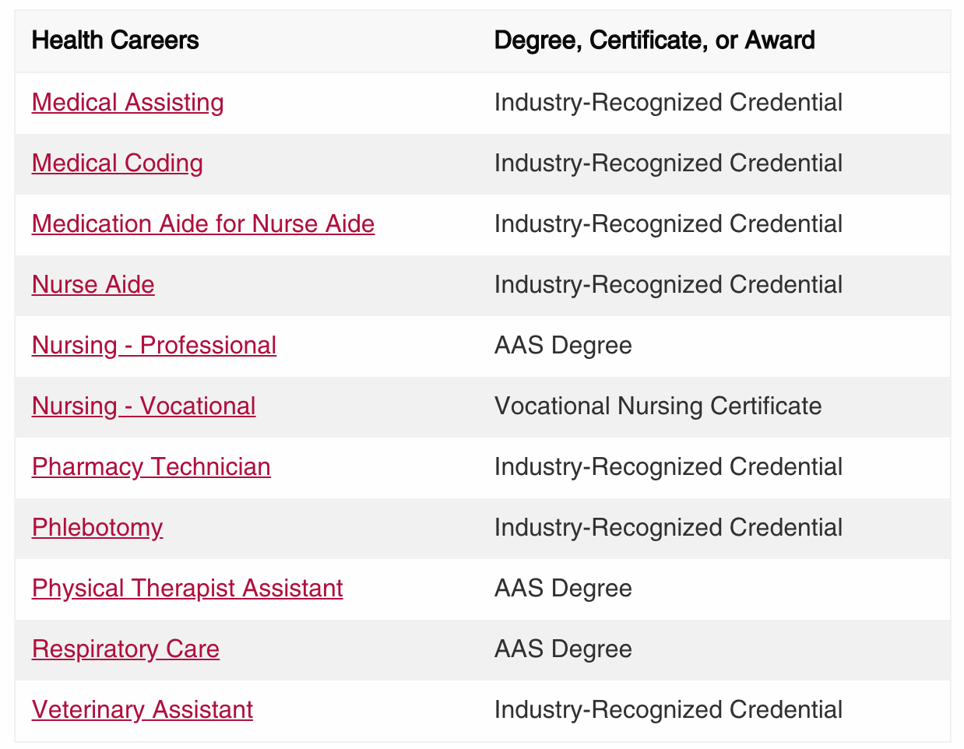
Current Successful Model
Victoria College of Nursing
  CNA Site: Gonzales, TX
    Cost: $475
    Scholarship Coverage: $375
>90% retainment of students in their respective hometowns
Many employers of these graduates later pay for continued educational advancement
Notes:
Cost $475
Scholarships of $375

Slide 12
Grants to Help Carry the Burden
Flex Program
Small Rural Hospital Improvement Grant Program
Rural Communities Health Care Investment Program (RCHIP)
Laura Jane Musser Fund: Rural Initiative Program
Texas Community Development Fund
Grants for Supportive Services and Senior Centers
Notes:
Flex Program:
https://www.ruralcenter.org/tasc/flex
Small Rural Hospital Improvement Grant Program
https://www.ruralcenter.org/ship
Rural Communities Health Care Investment Program (RCHIP)
https://www.ruralhealthinfo.org/funding/2820
Laura Jane Musser Fund: Rural Initiative Program
https://www.ruralhealthinfo.org/funding/1730
Texas Community Development Fund
https://www.ruralhealthinfo.org/funding/3325
Grants for Supportive Services and Senior Centers
https://hhs.texas.gov/doing-business-hhs/grants

Slide 13
Potential Action Plan
Physicians reach out to local congressman, county commissioners, TMA, in order to assess their respective county and regional needs.
Create a committee comprised of citizens of neighboring counties and towns
Effectively reallocate resources regionally between counties, especially those without a physician or family health practitioner
Use the funds that are saved through sharing resources and through applying for available grants to hire a social worker.
Use social worker to help coordinate health resources such as the voucher program and to collaborate between existing community programs such as technical certificate high school programs.
Promote service opportunities that are realistically sustainable for all volunteers involved
Incorporate the youth to support new and existing healthcare services
Notes:
Social

Slide 14
Estimated Costs
Pecos County Budget $56,000,000
Resources Allocated for Healthcare: $4,640,000
Cost of Our Program:
  Social Worker: $65,000
  Voucher Program: $1,560,000
  Total: $1,620,000

Slide 15
We want to see our rural communities not just survive, but thrive.

Slide 16
Ultimately, our goal is to utilize our best healthcare resource: people.

